Slide 1
Object Oriented System Design
Assignment #1

Slide 2
Board-game cafe
Board-game cafe inventory + finances management system
Create a program in the “Cafe” package
Renting out Board-games
Repairing Board-games
Buying Board-games

Slide 3
Class Game
Variables:
private String name
private String quality // Bad/Okay/Good
private double price
Methods:
Game(String name, double price) // Quality always starts at “Good”.
public String toString(); // returns game’s name, quality and price
public double getRepairCost(); // bad = 0,5 * price , okay = 0,2 * price
public void repair();
public void lowerQuality(); // Lowers the quality of the game by 1 tier.

Slide 4
Class Cafe
Variables:
private double money;
private Game[] gamesInCafe;
private Game[] rentedOutGames;
Methods:
public Cafe(Game[] games, double startingMoney);
public void rentOutGame(String name); // Cost of renting is the game’s price * 0.5
public void returnGame(String name);
public void buyGame(Game game);
public void printCafeDetails(); // Prints all games in the cafe and rented out, and the money in the register
public void repairGame(String name);
private int getIndexGamesInCafe(String name); // Helper function to get the index of the given game in the array, -1 if game doesn’t exist.
private int getIndexRentedOutGames(String name); // Helper function to get the index of the given game in the array, -1 if game doesn’t exist.

Slide 5
Class Cafe
The constructor initializes the cafe with 3 games and $5 in the register
When a game’s quality reaches “Bad” it cannot be rented out again until it is repaired.
Repairing is only possible if there is enough money in the cash-register.
rentOutGame() moves the game to the rentedOutGames[] and increases the money in the register by the game’s price * 0.5.
returnGame() decreases the game’s quality by 1 tier, and moves the game to the gamesInCafe[] array. (Good->Okay, Okay->Bad)

Slide 6
Main class
method main:
Initialize the Cafe
Rent out a game until it’s quality is ‘bad’ and repair it.
Rent out more games until you have enough money to buy a new one (think of one yourself).
Buy a new game.

Slide 7
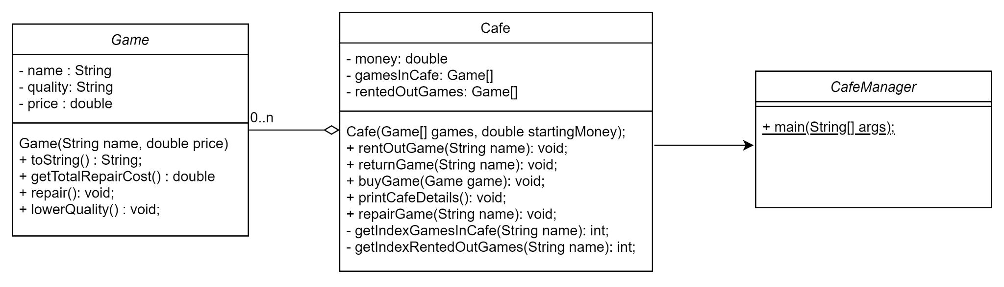
UML

Slide 8
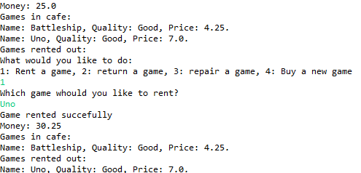
Visualization
Renting a game

Slide 9
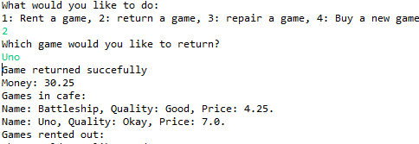

Visualization
Returning a game

Slide 10
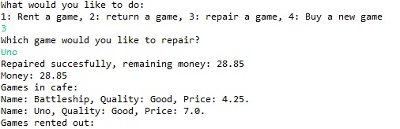
Visualization
Repairing a game

Slide 11
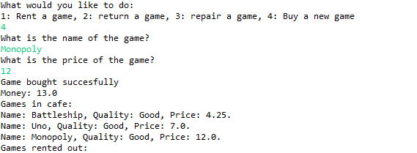
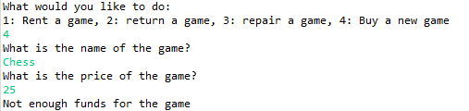
Visualization
Buying a game

Slide 12
Rules
Only regular arrays [], no Lists or Maps.
The arrays should be the same length as the amount of games in the cafe, so if the cafe has 3 games, the array should also be of length 3.
Use getters and setters when needed and only make them public if they are actually meant to be used from outside the class.
Reading code is more difficult than writing code, place comments in complex methods.

Slide 13
Submission
Submit your program code package(Assignment1_code_이름_학번) and design document (Assigment1_이름_학번) in LMS. (Korean/English)
The design document describes the main methods, flow of the code and overall design of the program. It should also mention and explain every method that you added that was not described in this powerpoint.
Deadline: 21st of april (4월 21일) 23:59
Late penalties:
Up to 24 hours = -25%,
24-48 hours = -50%,
48-72 hours = -75%
after 72 Hours you get an automatic 0.

